Slide 1

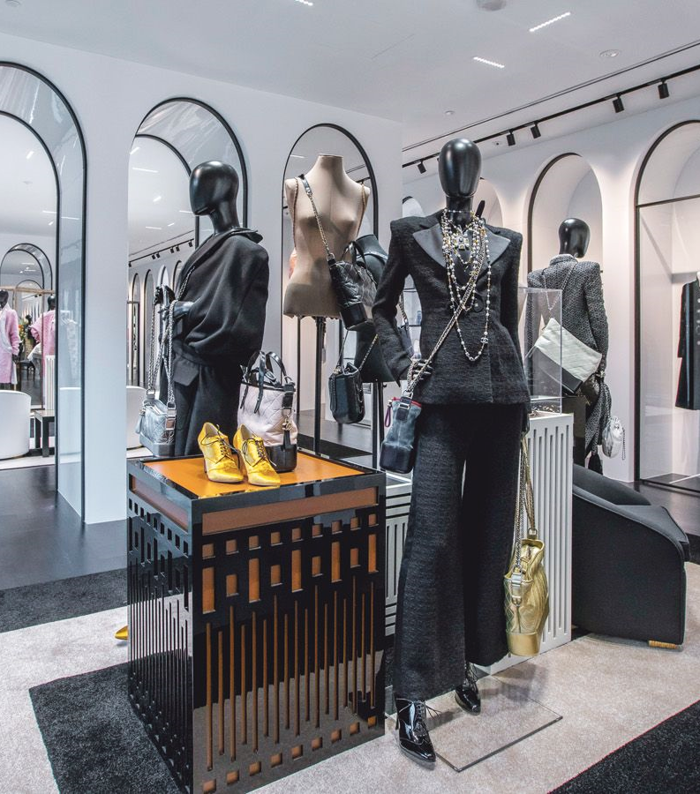

Live Class
Via Zoom
Chapter IV.
The Devil Wears Prada

Slide 2



Index / Índice. “The Devil Wears Prada”
1
Introduction
6
What to Wear and Where
2
Warm-up: Speaking Practise
7
My Style
3
Items of Clothing
8
On the Topic of Fashion
4
What are you wearing?
9
Dialogue: Going Shopping
5
Parts of Clothing
10
What have I learnt today? …
Book II: Linda in Real Life
Centro de Idiomas 2019

Slide 3
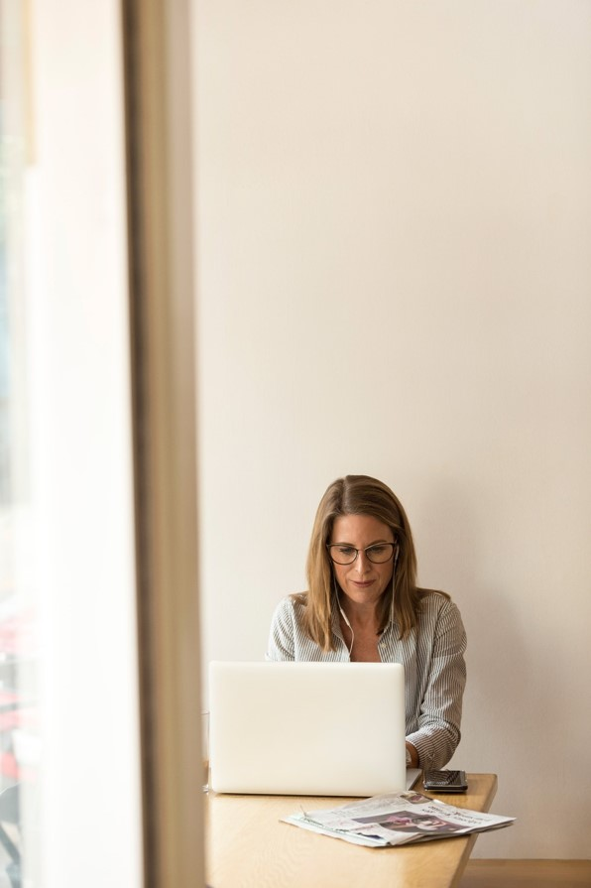
Part I. Introduction
Welcome to this live videoconference class!
In this final part of the chapter, you’ll put into practice everything you’ve learnt in the previous steps through dialogues, monologues, group discussion, games and other fun exercises.
The class is an important moment through which you can interact with your teacher and classmates in the contextualized situations from your virtual journey to learn English aboard.
Good luck!
¡Bienvenido / Bienvenida a esta clase por videoconferencia en vivo!
En esta parte final del capítulo, pondrás en práctica todo lo que has aprendido en los pasos previos a través de diálogos, monólogos, grupos de discusión, juegos y otros ejercicios divertidos.
La clase es un momento importante a través del cual puedes interactuar con tu maestro y compañeros en las situaciones contextualizadas de tu viaje virtual para aprender inglés en el extranjero.
¡Buena suerte!
Book II: Linda in Real Life
Centro de Idiomas 2019

Slide 4
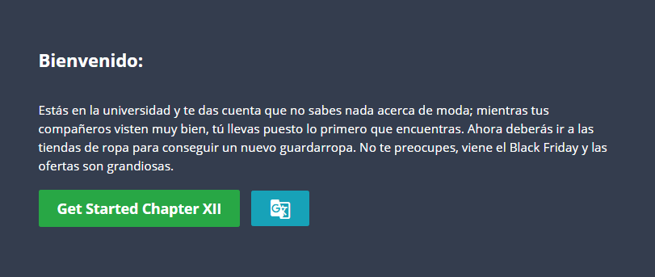
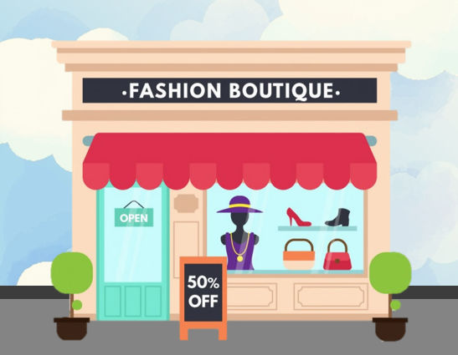
Part I. Class Objective
By the end of the class, you’ll be able to speak about shopping and clothing. You’ll be able to identify and say the names of different items of clothing, ask for prices, as well as express your own opinions and preferences relating to fashion.
Al final de la clase, serás capaz de hablar sobre compras y ropa. Podrás identificar y decir los nombres de diferentes prendas de vestir, solicitar precios y expresar tus propias opiniones y preferencias relacionadas con la moda.
Book II: Linda in Real Life
Centro de Idiomas 2019

Slide 5
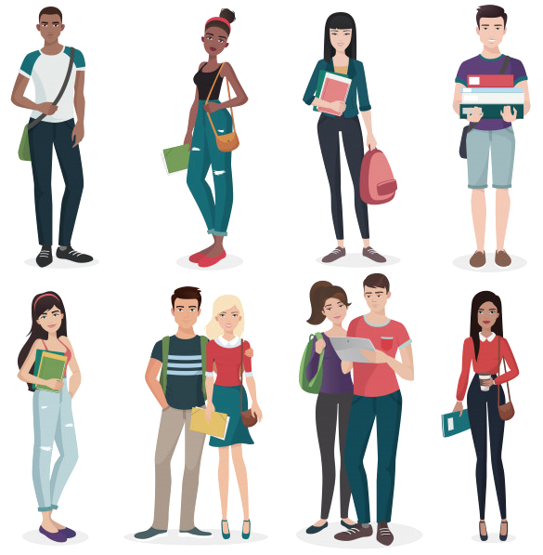
Part II. Warm-up Speaking Practise
What are you happy about today?
I’m happy today because …
What are you excited for in the class?
In the class, I’m excited for …
What do you want to practice?
Today, I want to practise …..
What did you like about this chapter?
In this chapter, I liked ….
What interests you about the topic?
The topic interests me because …
Book II: Linda in Real Life
Centro de Idiomas 2019

Slide 6
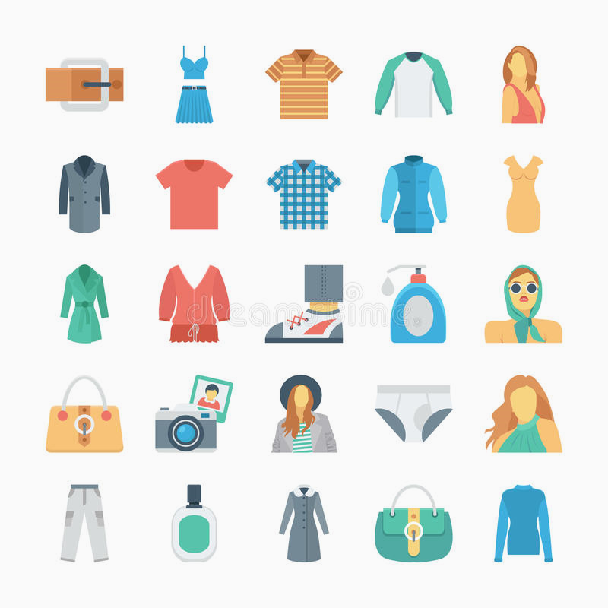
Part III. Items of Clothing
There is a belt.
There is a dress
There is a t-shirt
There is a longs leeve shirt
There is a coat
There is a t-shirt
There is a jacket
There is a purse
There are a photographic camera with a photo
There are a hat with a jacket
There is a underwear
There is a fragrance
There is a coat
Identify the items of clothing. You can use there is / there are from past classes.
Book II: Linda in Real Life
Centro de Idiomas 2019

Slide 7
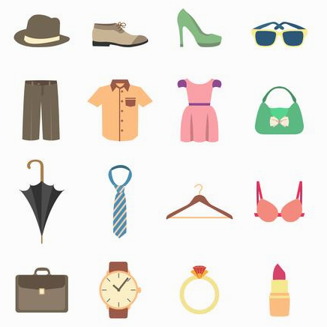
Part III. Items of Clothing
There is a hat
There is a shoe
There is a women’s shoe
There is a glasses
There is a pants
There is a shirt
There is a dress
There is a puse
There is a umbrella
There is a tie
There is a clothespin
There is a bra
There is a briefcase
There is a watch
There is a ring
There is a lipstick
Identify the items of clothing. You can use there is / there are from past classes.
Book II: Linda in Real Life
Centro de Idiomas 2019

Slide 8
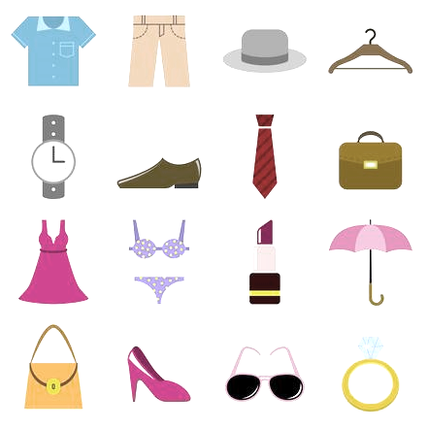
Part III. Items of Clothing
There is a skirt
There is a pants
There is a hat
There is a clothespin
There is a watch
There is a shoe
There is a tie
There is a briefcase
There is a dress
There are a women’s undereear
There is a lipstick
There is a umbrella
There is a purse
There is a women’s shoes
There is a glasses
There is a ring?
Identify the items of clothing. You can use there is / there are from past classes.
Book II: Linda in Real Life
Centro de Idiomas 2019

Slide 9
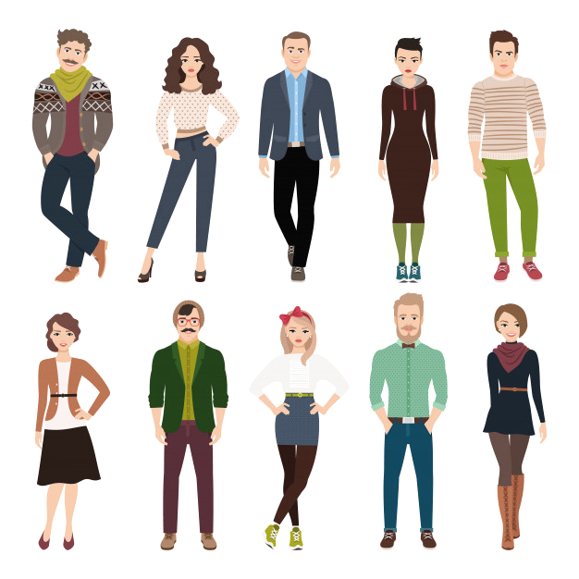
Part IV. What are you wearing?
Ask your classmates what they are wearing.
1) Hey David! What are you wearing today?
2) I’m wearing jeans, a shirt and trainers.
Can you remember what your classmates are wearing?
1) What is Sarah wearing today?
2) Sarah is wearing a skirt, a blouse and a hat.
Book II: Linda in Real Life
Centro de Idiomas 2019

Slide 10
Part IV. What are you wearing?
Now, describe what the people in the pictures are wearing.
1) What is the man on the left wearing?
2) He’s wearing a scarf, cardigan and jeans.
You can use colours in your descriptions for extra points.
1) What is the woman on the right wearing?
2) She’s wearing a black skirt and brown boots.
Book II: Linda in Real Life
Centro de Idiomas 2019

Slide 11
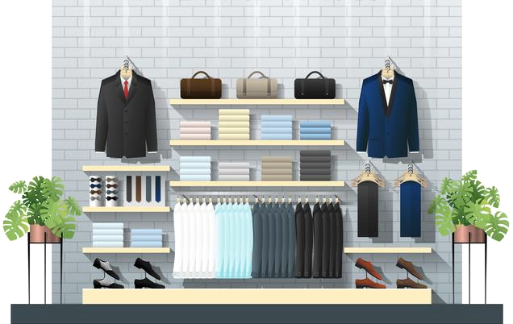
Part V. Parts of Clothing
Great, you can now identify types of clothes and colours.
It’s time to enter the Fashion Boutique and learn more about parts of clothes.
Book II: Linda in Real Life
Centro de Idiomas 2019

Slide 12
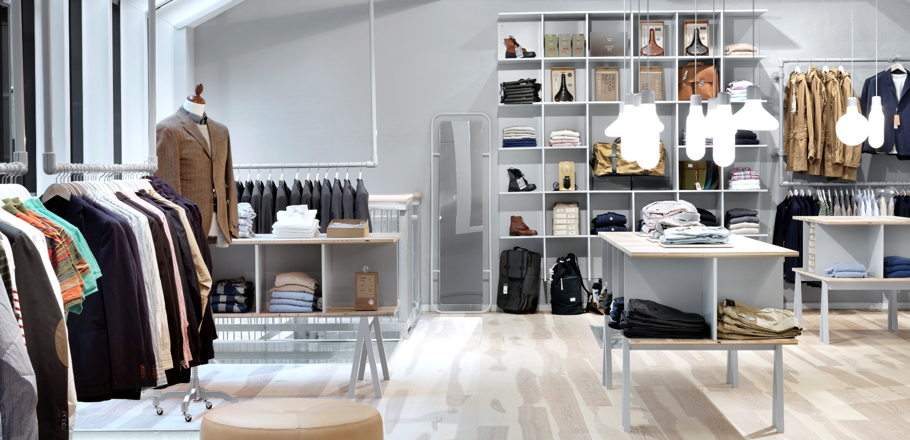
Part V. Parts of Clothing
Look at the photos & match the parts of clothes with the correct image.
Book II: Linda in Real Life
Centro de Idiomas 2019

Slide 13
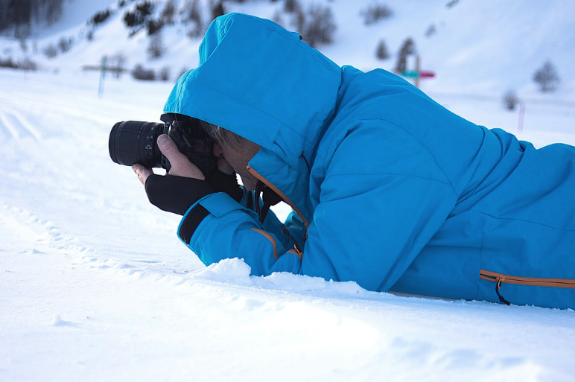
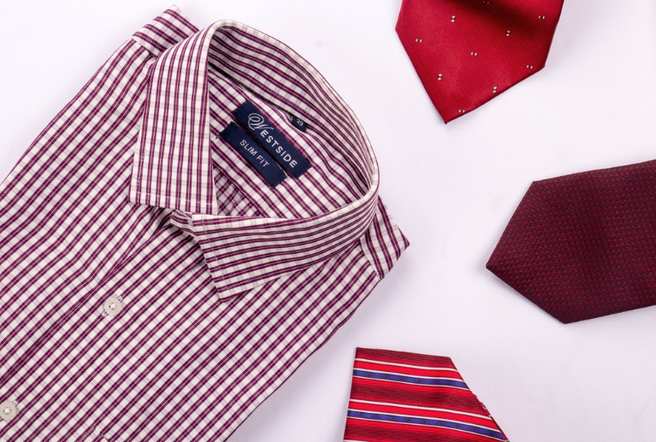
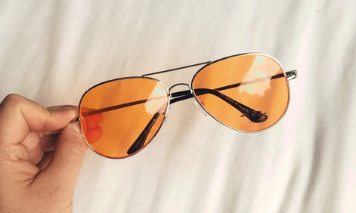
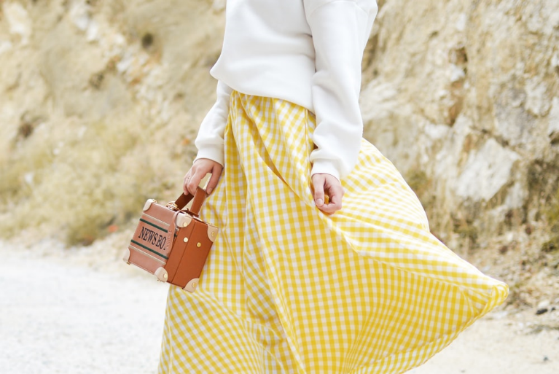
Part V. Parts of Clothing
Parts of clothes
Collar
Frame
Label
Hood
Zip
Lens
Sleeve
Button
Waist
Pocket
Waist
Book II: Linda in Real Life
Centro de Idiomas 2019

Slide 14
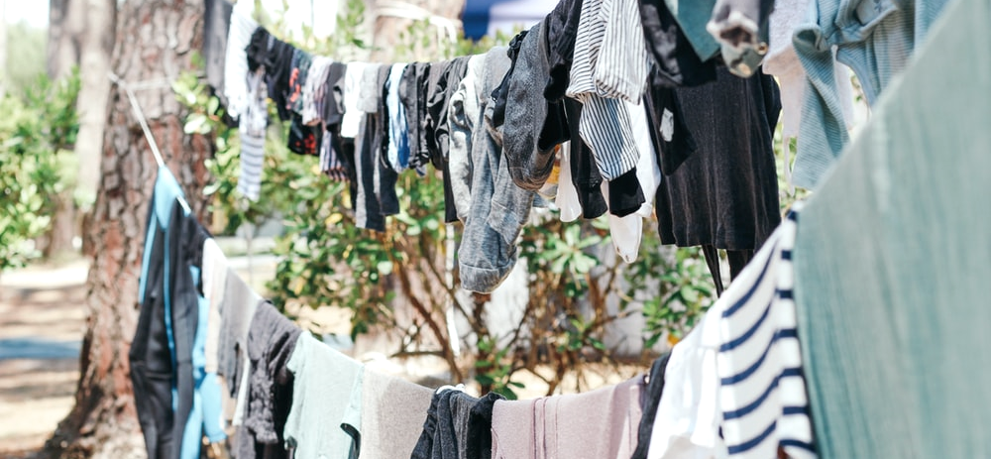
Part VI. What to Wear and Where
Look at the photos and decide the clothes you wear in these contexts.
Book II: Linda in Real Life
Centro de Idiomas 2019

Slide 15

Part VI. What to Wear and Where
Book II: Linda in Real Life
Centro de Idiomas 2019

Slide 16

Part VI. What to Wear and Where
Book II: Linda in Real Life
Centro de Idiomas 2019

Slide 17
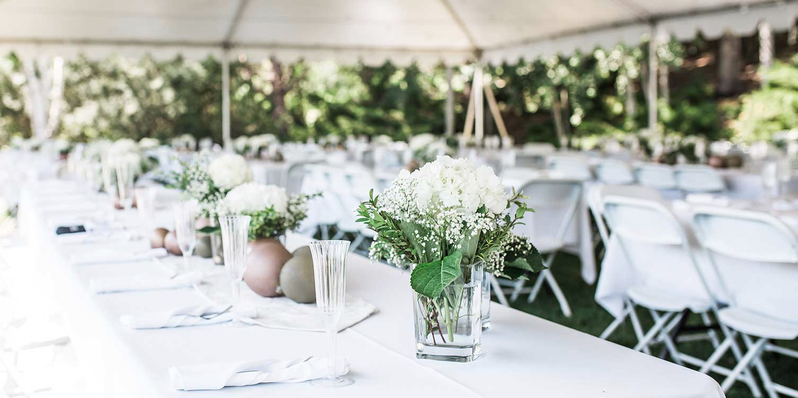
Part VI. What to Wear and Where
Book II: Linda in Real Life
Centro de Idiomas 2019

Slide 18

Part VI. What to Wear and Where
Book II: Linda in Real Life
Centro de Idiomas 2019

Slide 19
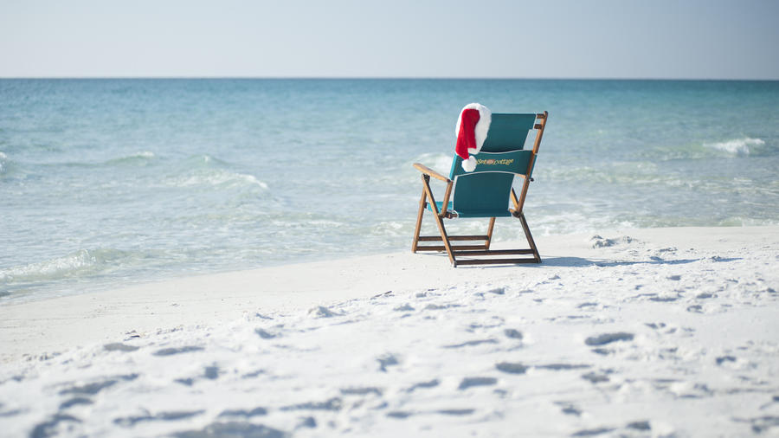
Part VI. What to Wear and Where
Book II: Linda in Real Life
Centro de Idiomas 2019

Slide 20
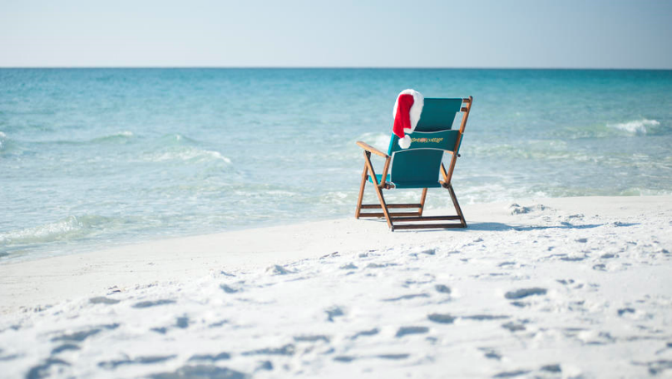
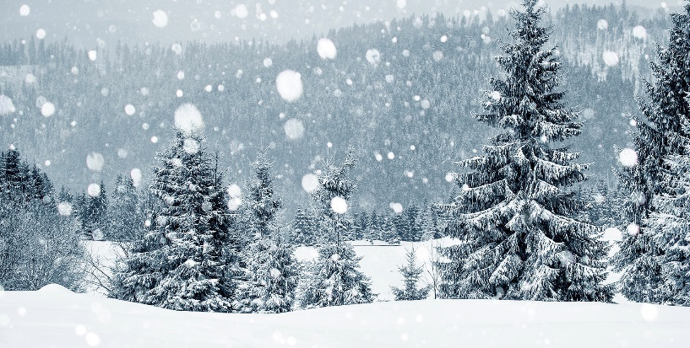
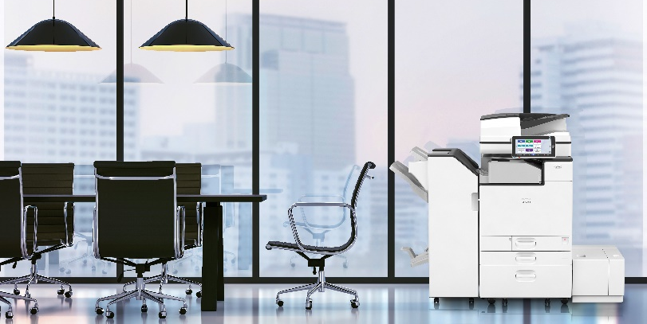
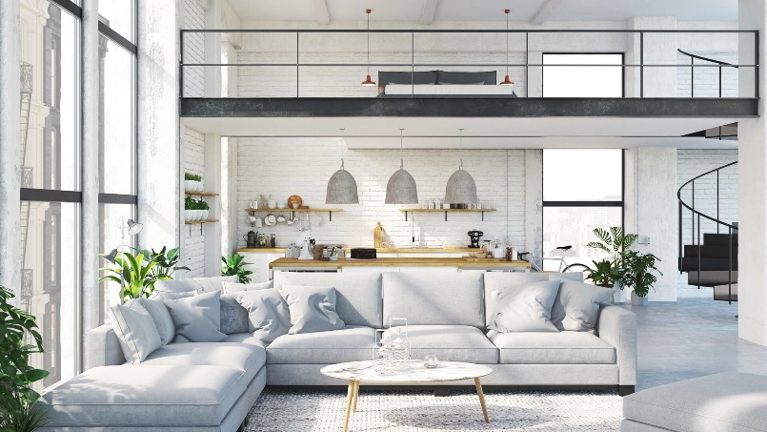
Part VI. What to Wear and Where
In hot weather, I wear …
In cold weather, I wear …
At work, I wear …
At home, I wear …
Book II: Linda in Real Life
Centro de Idiomas 2019

Slide 21
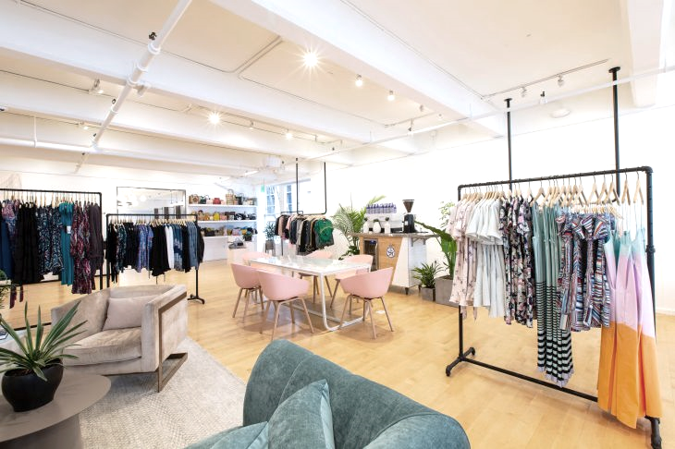
Part VII. My Style
Casual
Smart
Fashionable
Tight
Loose
Big
Small
Light colours
Dark colours
Cheap
Expensive
New
Old
Comfortable
Simple
Review the vocabulary to describe clothes, then tell the class about your fashion preferences.
Book II: Linda in Real Life
Centro de Idiomas 2019

Slide 22
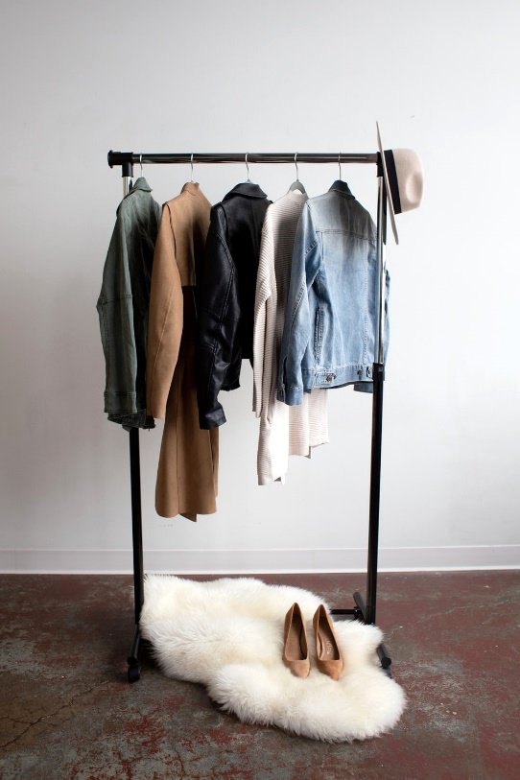
Part VIII. On the Topic of Fashion
Choose a question related to shopping & try to answer it in 60 seconds. If you give an answer using less time, you lose.
1) How much do you spend on clothes? Why?
2) Do you compare prices at different shops? Do you spend more for brand names?
3) Where do you like to go shopping? Why?
4) What’s your favorite clothing item? Why?
5) What is your favourite style of clothes? Why?
6) Do you prefer shopping in stores or shopping online? Why?
7) What is the most expensive item of clothing you have ever bought?
8) Do you think we should recycle and buy second-hand clothes?
Book II: Linda in Real Life
Centro de Idiomas 2019

Slide 23
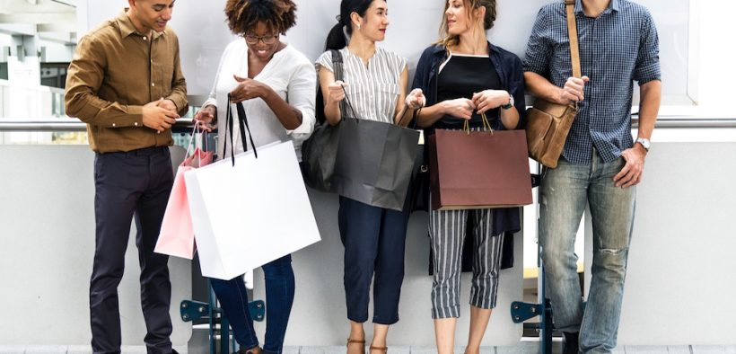
Part IX. Going Shopping
Instructions: You go shopping for some new clothes. Create a dialogue between a shop assistant and a customer to describe the clothes you want.
Book II: Linda in Real Life
Centro de Idiomas 2019

Slide 24
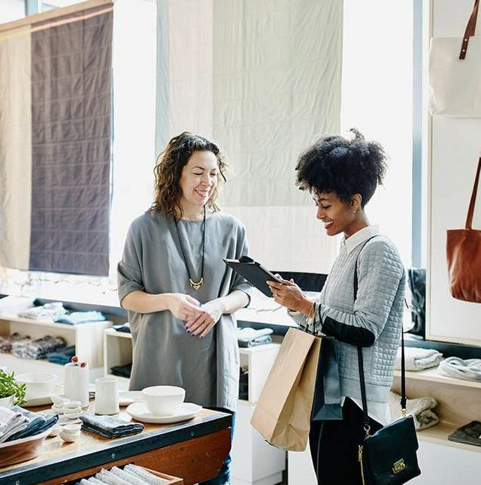
Part IX. Going Shopping
Useful phrases for the assistant:
Hello / Hi. How can I help
2) What items / style of clothing are you looking for?
3) What size do you wear?
4) The price is …..
5) Thank you. Take care.
Useful phrases for the shopper:
1) I’m looking for ….
2) I want a …… style.
3) I wear a small / medium / large / extra large.
4) How much does it cost?
5) Thanks for helping.
Book II: Linda in Real Life
Centro de Idiomas 2019

Slide 25
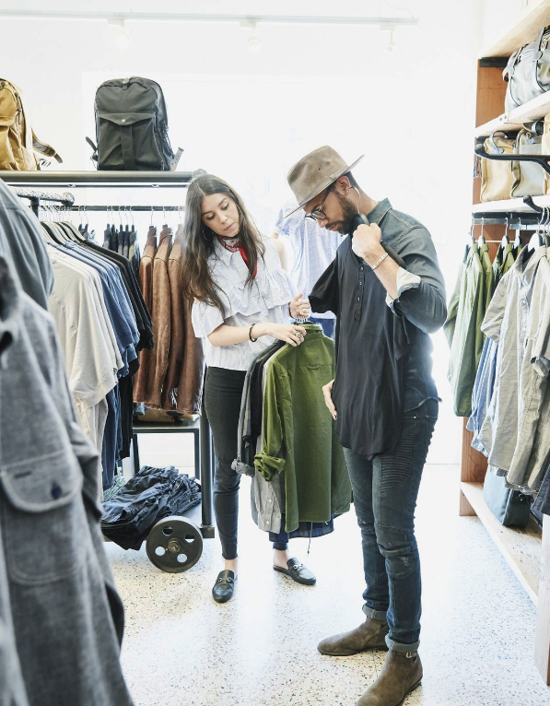
Part IX. Going Shopping
Instructions: You go shopping for some new clothes. Create a dialogue between a shop assistant and a customer to describe the clothes you want.
1) Good afternoon. How can I help you?
2) I want some new sweaters and shoes.
1) What style do you usually wear?
2) I wear a casual style with light colours.
1) ………………………………………….............
2) ……………………………………………………
1) ……………………………………………………
2) ……………………………………………………
1) ………………………………………….............
2) ……………………………………………………
1) ……………………………………………………
2) ……………………………………………………
Book II: Linda in Real Life
Centro de Idiomas 2019

Slide 26
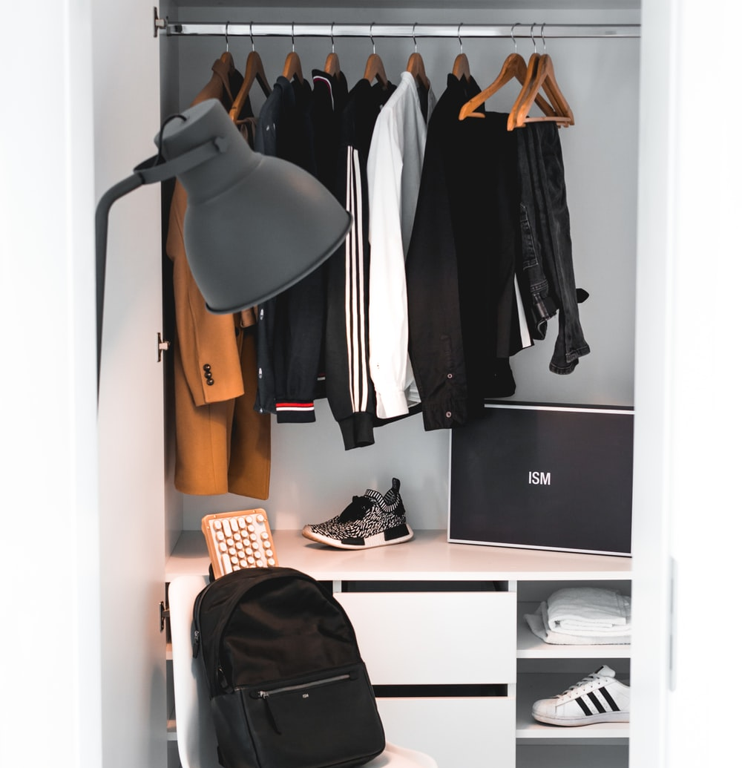
Part X. Game – 20 Questions
Instructions: Think of an items of clothing but don’t say it. The other students will try to guess your word by asking questions. You can only answer the questions with the words ‘Yes’ or ‘No’.
A) Can you wear this item at work?
B) Yes
A) Do you wear this item in cold weather?
B) No
A) Does this item have a buttons? …..
Book II: Linda in Real Life
Centro de Idiomas 2019

Slide 27
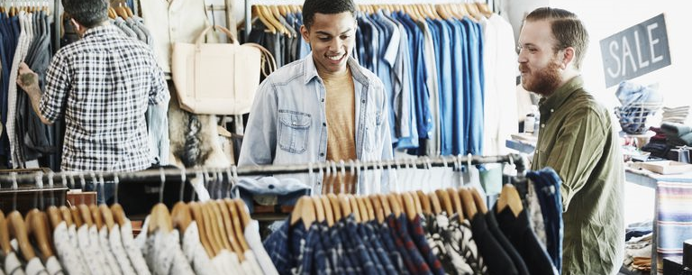
Part X. What have I learnt today?
What have I learnt today?
I can speak about shopping and clothing. I can identify and say the names of different items of clothing, ask for prices, as well as express my own opinions and preferences relating to fashion.
Book II: Linda in Real Life
Centro de Idiomas 2019

Slide 28
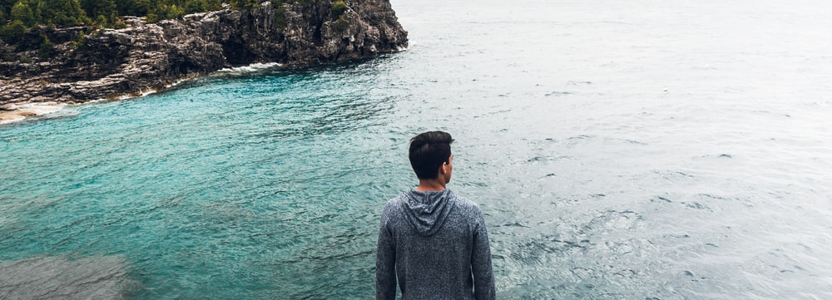
Part X. End of Part I
Congratulations! You finished Part I of “Linda in Real Life” and the first four chapters of your adventure in Canada.
Keep going with your adventure and never give up!
Book II: Linda in Real Life
Centro de Idiomas 2019

